Slide 1
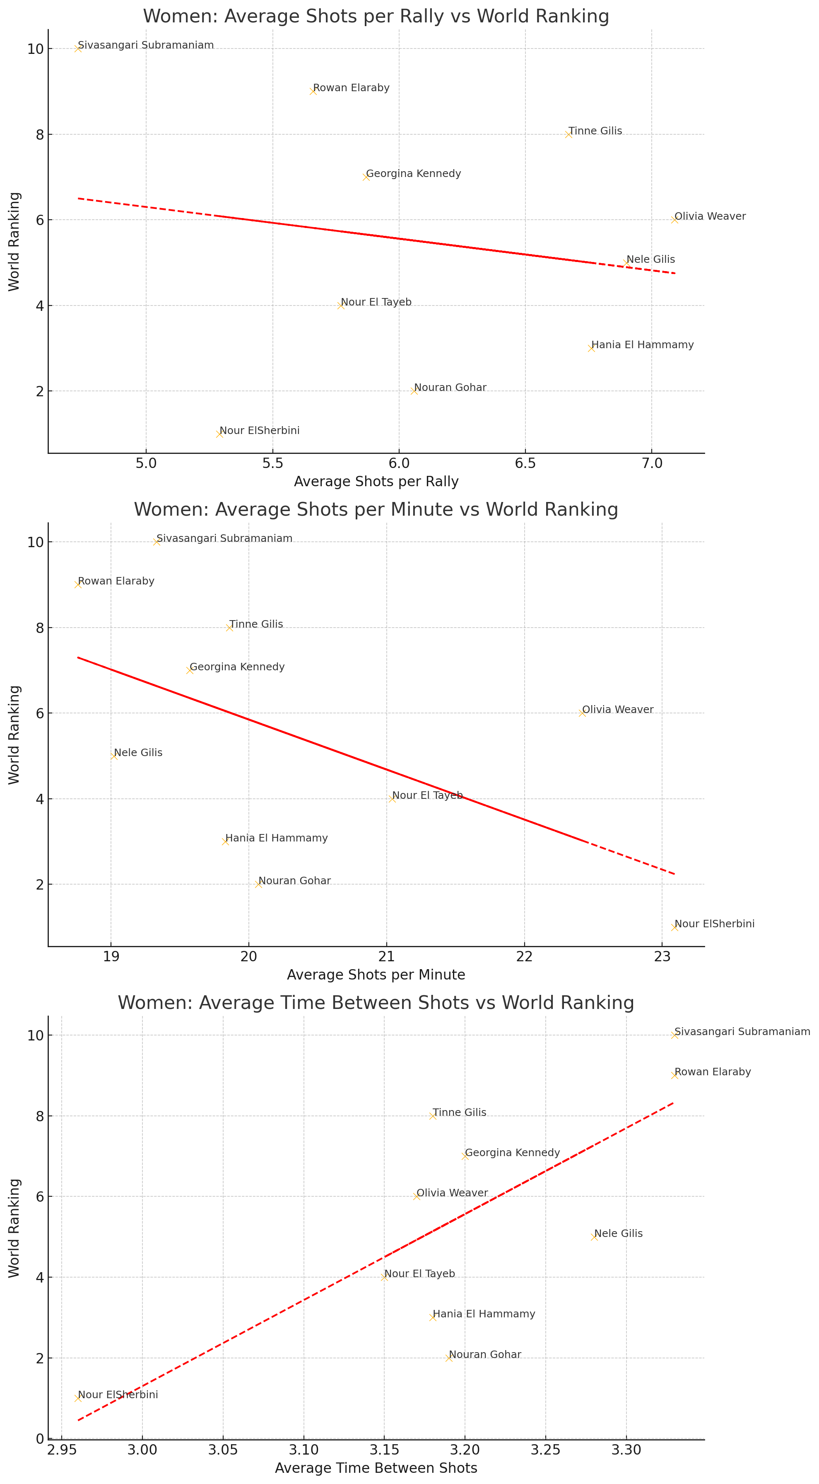
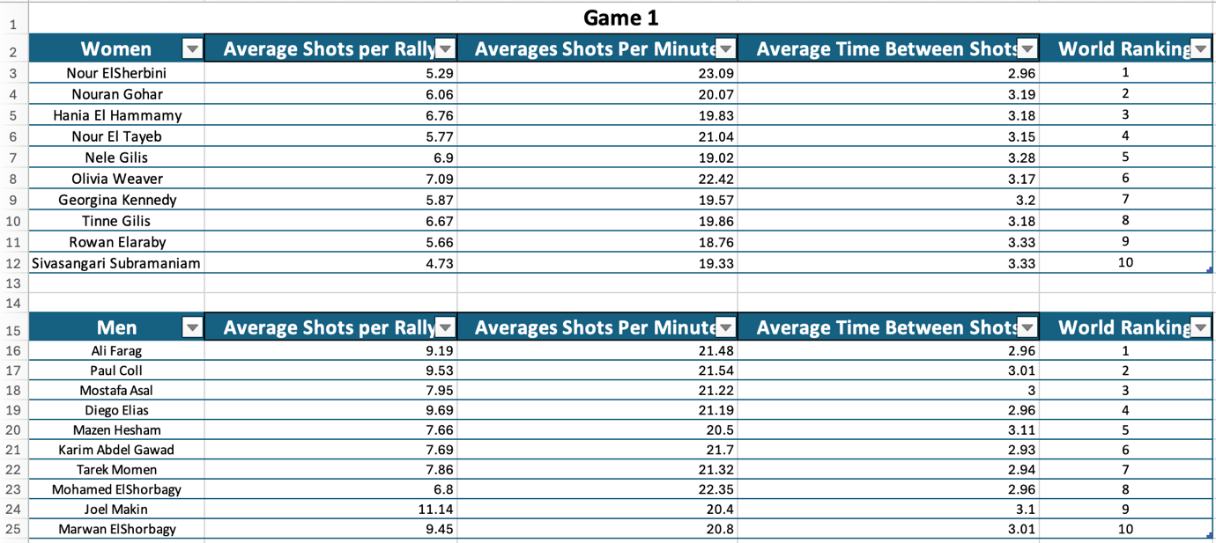
Can we measure rally intensity effectively and if so, are we able to profile players? If so, how does this relate to match outcomes and world ranking?
Introduction
Discussion
When it comes to the kinematics and dynamics of squash at the highest level, there has been very little research done, even though the sport is both strategic and has a long and illustrious history. Even though research conducted by Vučkovič et al. (2013) and Hughes and Franks (1994) have provided valuable insights about shot selection and court placement, there is a significant knowledge gap concerning the intensity of rallies and the impact they have on the outcomes of games.
By Samuel watts
Higher Intensity and Match Success:
Explanation: Both women and men players who maintain higher rally intensity (measured by shots per minute) and shorter times between shots tend to have better world rankings.
Implication: Training programs focusing on improving players' ability to play fast-paced rallies could enhance their performance and ranking. Emphasis should be on fitness, quick decision-making, and shot precision.
Strategic Play:
Women: Efficiently winning points with fewer shots per rally is beneficial. This suggests a strategy focused on precision and effective shot placement to quickly win points.
Men: Engaging in longer rallies with sustained intensity is advantageous. This indicates that endurance and the ability to maintain a high level of performance over extended rallies are key factors for success.
Correlation with Rankings:
Women: A stronger correlation between high-intensity metrics (shots per minute and time between shots) and world rankings.
Men: Although the correlation is present, it is less pronounced for shots per minute, suggesting a balance between rally length and tempo.
Method
Results
Squash rules have evolved over time, particularly the alterations that were made in 2009 including the 11-point-per-rally (PPR) scoring system and a reduced tin height. These modifications have resulted in changes to the game's mechanics. A more aggressive play style has emerged because of these advancements; the current sport of squash is characterised by rallies that are shorter and more forceful. While this is going on, the research that has been done up until now has not completely studied how these advancements affect player performance and strategic choices.
Tournaments in Focus
1. Open of the American at Philadelphia in 2023 2. The Hong Kong Open Twenty-three, Hong Kong 2023 3. Boynton Beach will host the Florida Open in 2024. 4. Tenth Annual Tournament of Champions, New York, 2024 5. Grasshoppers Cup, held in Zurich in the year 2023 6. The Malaysia Cup will be held in Kuala Lumpur in the year 2023.
Men:
Short Rallies (1-4 shots): 33% of all rallies
Medium Rallies (5-8 shots): 42% of all rallies
Long Rallies (9+ shots): 25% of all rallies
Women:
Short Rallies (1-4 shots): 37% of all rallies
Medium Rallies (5-8 shots): 38% of all rallies
Long Rallies (9+ shots): 25% of all rallies.
Aims
Men:
Average Shots per Rally: Mean (8.50), Median (8.57), Range (4.34)
Average Shots per Minute: Mean (21.27), Median (21.36), Range (1.95)
Average Time Between Shots: Mean (2.99), Median (2.98), Range (0.18)
Women:
Average Shots per Rally: Mean (6.08), Median (5.92), Range (2.36)
Average Shots per Minute: Mean (20.79), Median (19.95), Range (4.33)
Average Time Between Shots: Mean (3.19), Median (3.18), Range (0.37)
•To investigate the relationship between the results of matches and the intensity of rallies.
•To investigate if or not the global rankings of players are correlated with the intensity of rallies.
Angles®, a video analysis program, will be used to collect data from 244 different matches. The length of the rally, types of shots, and the number of shots fired during each rally are some of the relevant measures.
Time between shots (TB) and shots per minute (SPM) are the two primary measurements that will be utilised to ascertain the effectiveness of the intensity matrix. Video footage that is analysed frame by frame will ensure that accurate data collection is accomplished.
The close mean and median values for both TB and SPM suggest a normal distribution among players. The slightly higher mean TB and lower mean SPM in women’s matches indicate a marginally slower pace compared to men’s matches. The standard deviations reflect some variability in rally intensity, with men showing slightly more variation in SPM than women.
Issues Relating to Research
•When it comes to squash, is it possible to accurately evaluate the rally intensity by using TB and SPM measures?
•What kinds of effects could different rally strengths have on the outcomes of matches?
•Is there a significant connection between the world rating of a player and the intensity of their rally effort?
•In terms of the selection of shots and the movement of players, what are the characteristics that are common to high-intensity rallies?
Men Players
Average Shots-per Rally vs. World Ranking:
Trend: Positive correlation.
Explanation: Higher-ranked male players tend to engage in longer rallies with more shots. This could indicate their endurance, patience, and ability to sustain high performance over longer points. Notable Players:
Ali Farag: With an average of 9.19 shots per rally, he ranks first, showing that sustained rallies are a part of his successful strategy.
Average Shots per Minute vs. World Ranking:
Trend: Weak negative correlation.
Explanation: While a higher rate of shots per minute is slightly correlated with better rankings, the relationship is not as strong as for women. This might suggest that men’s matches balance between tempo and rally length.
Paul Coll: With 21.54 shots per minute, his second-place ranking supports the importance of tempo.
This study's primary variables are as follows: The length of each rally, stated in seconds, is referred to as the rally length (RL). The overall count of shots hit inside a rally is referred to as the shots Per Rally (SPR) metric. By dividing the RL by the SPR, the time between shots (TB) can be calculated as follows: The Shots Per Minute (SPM) is determined by first dividing the SPR by the RL and then multiplying the result by sixty (SPM = (SPR/RL) x 60)
Shorter TB and Higher SPM Correlate with Winning Matches: Players who won matches generally had shorter TB and higher SPM, indicating that a faster pace is advantageous.
High-Intensity Players Have Better World Rankings: Players in Cluster 1 (high intensity) generally had higher world rankings compared to players in Clusters 2 and 3.
Shot Type and Outcome: Volleys and kills were more frequent in high-intensity rallies. Successful players used a higher proportion of these shots, which contributed to faster rallies and better outcomes.
Match Stage Influence: Intensity metrics varied by match stage, with higher intensity observed in the final stages of the tournaments compared to the initial rounds.
The findings of this research provide significant new insights into the dynamics of rally intensity in the sport of competitive squash. The primary findings indicate that two significant variables, namely Time Between Shots (TB) and Shots Per Minute (SPM), play a significant role in distinguishing between player performance and have a strong correlation with the outcomes of matches and the ranks of professionals throughout the world.
conclusion
This research demonstrates, in general, the significant role that rally intensity plays in the performance of professional squash players. It is possible to have a better understanding of the global rankings, match results, and player performance by utilising the measurements of TB and SPM. At the top levels of the sport, the most important factor in determining success is high-intensity play, which is characterised by shorter time frames and increasing speed per minute. Because of the findings, data-driven solutions to increase player performance have been developed, which will influence training and coaching.
references
Vučković, G., James, N., Hughes, M., Murray, S., Sporiš, G., & Perš, J. (2013). The effect of court location and available time on the tactical shot selection of elite squash players. DOAJ (DOAJ: Directory of Open Access Journals). [Google Scholar]
Hughes, M., & Franks, I. M. (1994). Dynamic patterns of movement of squash players of different standards in winning and losing rallies. Ergonomics, 37(1), 23–29. [Google Scholar]
Notes:
These findings could be expanded upon in subsequent research by looking into additional factors, such as
psychological aspects,
player fatigue, and
decision-making strategies utilised during the game.
The use of physiological data, such as the lactate threshold or heart rate, could be of assistance in acquiring a more comprehensive understanding of the physical requirements that are associated with high rally intensity.
Additional steps that could be taken to enhance the generalizability of the results include increasing the number of tournaments and the size of the sample size in the dataset.
Time Restriction
human error

